Slide 1
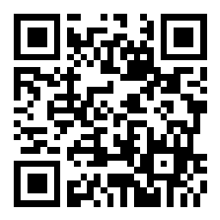
EECS 370 - Lecture 2
Poll: Why is multiplying numbers by 100 easier than multiplying by 128?
ISA and Binary
Live Poll + Q&A: slido.com #eecs370
Poll and Q&A Link

Slide 2

Unresolved questions from last time
"Is there a reason that most programming languages are open source but architectures IP?"
Designing hardware is expensive!
Anyone can write software: incentive to develop toolchains and share them with people
Actually implementing a processor design takes millions of dollars. Mostly only specialized companies develop toolchains, and sell them to other companies for big $$$
But that's gradually changing!
Remember, you can post questions on Slido, or fill out this "end of lecture" form:
Live Poll + Q&A: slido.com #eecs370

Slide 3
Announcements
HW 0
Posted on website, due Wednesday
P1
Released soon
Setup clinic
Friday
Need help getting your debugger setup?
OH
Going on now: see website->Google Calendar->Office Hours

Slide 4
My Office Hours
2 types:
Group:
In-person
T/Th - 30 minutes right after class (3901 BBB)
Prioritize group questions over individual debugging
Starting this Thursday
Individual:
Wednesday – 4:30-5:30
Over Zoom (for now) – see website for link
One-on-one: any questions welcome

Slide 5
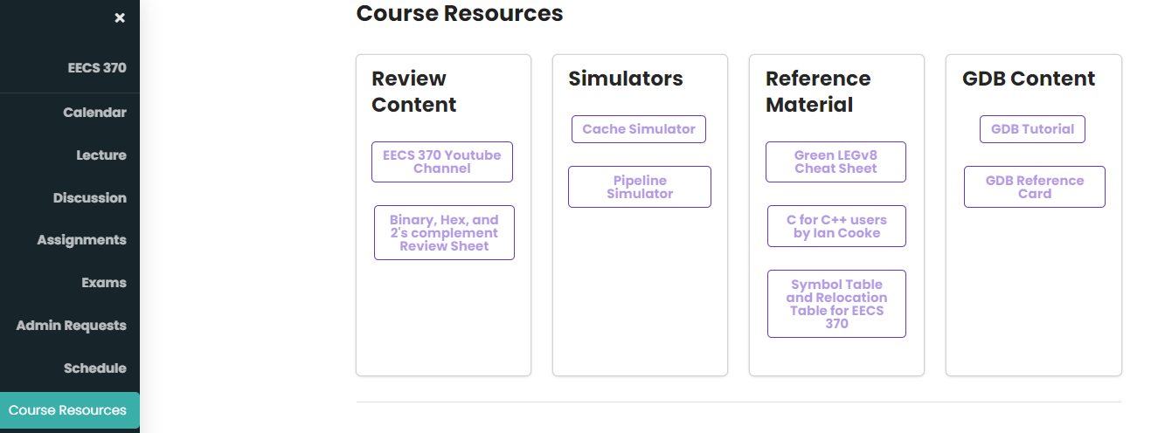
Extra Resources
Want more examples on binary? Two's complement?
See "resources tab" on website
Extra videos, review sheets

Slide 6
Instruction Set Architecture (ISA) Design Lectures
Lecture 2: ISA - storage types, binary and addressing modes
Lecture 3 : LC2K
Lecture 4 : ARM
Lecture 5 : Converting C to assembly – basic blocks
Lecture 6 : Converting C to assembly – functions
Lecture 7 : Translation software; libraries, memory layout

Slide 7
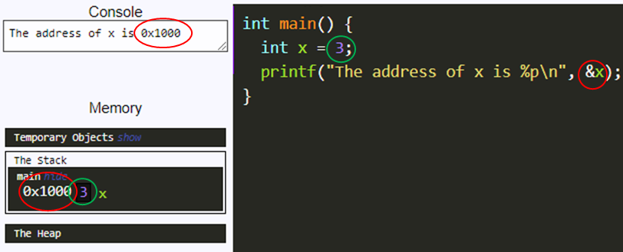
Basic Computer Model
You know from 280 that computers have "memory"
Abstractly, a long array that holds values
Every piece of data in a running program lives at a numerical address in memory
You can see the address in C by using the "&" operator
Most programs work by loading values from memory to the processor, operating on those values, and writing values back into memory

Slide 8
Basic Memory Model
1st question in understanding how programs run on computers:
How are values actually represented in memory?
Answer: binary

Slide 9

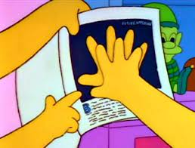
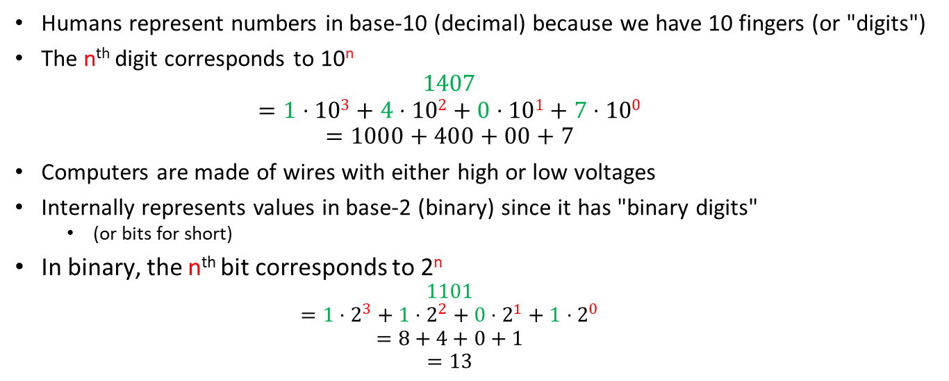
Aside: Decimal and Binary
Humans represent numbers in base-10 (decimal) because we have 10 fingers (or "digits")
The n^{th} digit corresponds to 10^{n}
$$1407$$
$$=1⋅103+4⋅102+0⋅101+7⋅100$$
$$=1000+400+00+7$$
Computers are made of wires with either high or low voltages
Internally represents values in base-2 (binary) since it has "binary digits"
(or bits for short)
In binary, the n^{th} bit corresponds to 2^{n}
$$1101$$
$$=1⋅2^{3}+1⋅2^{2}+0⋅2^{1}+1⋅2^{0}$$
$$=8+4+0+1$$
$$=13$$
Collection of 8 bits is called a byte
Does Bart Simpson count in octal?

Slide 10
Aside: Hexadecimal
A bunch of 0s and 1s is hard to read for humans
But translating to decimal and back is tricky
Solution: Bases that are a power of 2 are easy to translate between, since a fixed group of bits corresponds to one digit
In practice, base-16 or hexadecimal is used
Digits 0-9, plus letters A-F to represent 10-16

Slide 11
Aside: Hexadecimal
Represent binary using 0b. Hex using 0x. If not specified, it's decimal
Every 4 bits corresponds to 1 hex digit (since 2⁴=16)
(binary) 0b 0010 0101 1010 1011
(hexadecimal)0x 2 5 A B
0x25AB
Live Poll + Q&A: slido.com #eecs370

Slide 12
Operating on Binary Values
All values are stored in binary, even when you specify the number in decimal
It is often convenient to treat values as sequences of bits, rather than values
You will need to do this in P1a
C provides "bitwise operators" to do this
Shift ("<<" and ">>")
Bitwise boolean ("&", "|", "^", and "~")

Slide 13
Shift Operators
Shift a value x bits to the left via "<<"
Inserts "x" zeros to the right (least significant)
E.g.
int a = 60;
int s = a << 2;

Slide 14

Shift Operators
Shift a value x bits to the left via "<<"
Inserts "x" zeros to the right (least significant)
E.g.
int a = 60; // 0b0011_1100
int s = a << 2; // 0b1111_0000
"a" is still 60, "s" is 240
Same idea for ">>", but to the right
shifting $x$ to the left in decimal $→$ multiplying by $10x$
shifting $x$ to the left in binary $→$ multiplying by $2x$

Slide 15
Bitwise operations
Bitwise operations apply a Boolean operation on each bit of a value (or each pair of bits across two values)
int a = 60; // 0b0011_1100
int b = 13; // 0b0000_1101
int o = a | b;

Slide 16
Bitwise operations
Bitwise operations apply a Boolean operation on each bit of a value (or each pair of bits across two values)
int a = 60; // 0b0011_1100
int b = 13; // 0b0000_1101
int o = a | b; // 0b0011_1101
"a" and "b" are the same, "o" is 61
& – and | – or ^ – xor ~ – not
Very different from Boolean &&, ||, etc
Why?

Slide 17
Different Data Types
How does memory distinguish between different data types?
E.g. int, int *, char, float, double
It doesn't! It's all just 0s and 1s!
We'll see how to encode each of these later
Exact length depends on architectures

Slide 18
Minimum Datatype Sizzes
Type | Minimum size (bits)
char | 8
int | 16
long int | 32
float | 32
double | 64

Slide 19
Where do ISAs come into the game ?
Application software
Compilers
ARCHITECTURE – a.k.a. ISA (Instruction Set Architecture) - Platform-specific - a limited set of assembly language commands "understood" by hardware (e.g. ADD, LOAD, STORE, RET)
The hw/sw
divide
MICROARCHITECTURE (Hardware implementation of the ISA) - Intel Core i9/i7/i5 implements the x86 ISA (desktop laptop) - Apple A9 implements the ARM v8-A ISA (iPhone)
Circuits
Devices

Slide 20
How is Assembly Different from C/C++?
C/C++: string multiple operations & operands in one statement:
x = a + b + c - d
In assembly, you can
only specify one of a fixed number of operations per statement, and
have a fixed number of operands per statement
ADD r1, r2, r3 // equivalent to r1 = r2 + r3
Complex Instruction Set Computing (CISC) ISAs focus on having many, complex instructions to make programming easier
E.g. x86, not discussed in this class
Reduced Instruction Set Computing (RISC) ISAs focus on having fewer, simpler instructions to ease hardware design
E.g. LC2K, ARM (sorta), primary focus of this class

Slide 21
How is Assembly Different from C/C++?
C/C++ instructions operate on variables
e.g.
x = i+j;
Practically unlimited
Assembly instructions operate on memory locations or registers
e.g.
add r1, r2, r3
ld r1, 0x1000
Registers are basically a small number (~8-32) of fixed-length, hardware variables that have simple names like "r5"

Slide 22
Example Architectures
ARMv8—LEGv8 subset from P+H text book
32 registers (X0 – X31)
64 bits in each register
Some have special uses e.g. X31 is always 0—XZR
Intel x86 (not discussed much in this class)
4 general purpose registers (eax, ebx, ecx, edx) 32 bits
Special registers: 3 pointer registers (si,di,ip), 4 segment (cs,ds,ss,es),
2 stack (sp, bp), status register (flags)
LC2K (simple architecture made up for this class)
8 registers, 32 bits each

Slide 23
How is Assembly Different from C/C++?
C/C++: next line of code is executed until you get to:
function call
return statement
if statement or for/while loop
etc
Assembly: a program counter (PC) keeps track of which memory address has the next instruction, gets incremented until
a "branch" or "jump" instruction
Used to change control flow (more later)

Slide 24
Traditional (von Neumann) Architecture
We're used to thinking about program code and data being separate
But in practice, both are stored in the same memory
That's why things like "function pointers" in C/C++ work
This is the basis of the von Neumann Architecture

Slide 25
Traditional (von Neumann) Architecture
Here’s the (endless) loop that hardware repeats forever:
Fetch—get next instruction–use PC to find where it is in memory and place it in instruction register (IR)
PC is changed to “point” to the next instruction in the program
Decode—control logic examines the contents of the IR to decide what instruction it should perform
Execute—the outcome of the decoding process dictates
an arithmetic or logical operation on data
an access to data in the same memory as the instructions
OR a change to the contents of the PC

Slide 26
(Simplified) System Organization
Let's execute this short program:
ADD X0, X1, X2
SUB X1, X2, X0
Memory
CPU
Address FFFF…
Address 0000
Registers
ALU
Load
X0 | 0
X1 | 7
X2 | -3
ADD X0, X1, X2
Address 0102
+
Store
32 x 64 bits
Program counter
0102
Gigabytes to Terabytes
0102

Slide 27
(Simplified) System Organization
Let's execute this short program:
ADD X0, X1, X2
SUB X1, X2, X0
Memory
CPU
Address FFFF…
Address 0000
Registers
ALU
Load
X0 | 4
X1 | 7
X2 | -3
SUB X1, X2, X0
Address 0103
+
Store
32 x 64 bits
Program counter
0103
Gigabytes to Terabytes
0103

Slide 28
(Simplified) System Organization
Let's execute this short program:
ADD X0, X1, X2
SUB X1, X2, X0
Memory
CPU
Address FFFF…
Address 0000
Registers
ALU
Load
X0 | 4
X1 | -7
X2 | -3
+
Store
32 x 64 bits
Program counter
0104
Gigabytes to Terabytes

Slide 29
Assembly Code – ARM Example
ARM v8 ISA
Poll: What are the final contents of X1,X2, and X3?
What are the contents of the registers after executing the given assembly code (destination register is listed first in ARM)?
opcode d s1 s2imm
X1
25
Program:
ADD X3, X1, X2
Initial
register file:
X2
-4
ADDI means "add immediate", the last field is a literal value, not a register index
X3
57
ADDI X3, X3, #3
SUB X2, X3, X1
(1) ADD X3, X1, X2
(2) ADDI X3, X3, #3
(3) SUB X2, X3, X1
X1
25
X1
25
X1
25
X1
25
X2
-4
X2
-4
X2
-4
X2
-1
X3
57
X3
21
X3
24
X3
24
Live Poll + Q&A: slido.com #eecs370

Slide 30
How is Assembly Different from C/C++?
No data types in assembly
Everything is 0s and 1s: up to the programmer to interpret whether these bits should be interpreted as ints, bools, chars… or even instructions themselves!
char c = 'a';
c++; // c is now 'b'
// results in the same assembly as
int x = 97;
x++; // c is now 98

Slide 31
How is Assembly Different from C/C++?
1000011 could be interpreted as:
Signed number: -61
Unsigned number: 67
A float: 9.38e-44
A character: 'C'
LC2K Instruction: 'add 0 0 3'
How did I get these?

Slide 32
Representing Values in Hardware
Unsigned integers represented as we've seen
Chars are represented as ASCII values
e.g. 'a' -> 97, 'b' -> 98, '#' -> 35
What about negative numbers?
Fractional numbers?

Slide 33
Negative Numbers
There are many ways we could represent negative numbers
Because it will eventually make our hardware simpler, the most common representation is 2's complement
Hey, Good-Looking!
2
No, not 2's compliment!

Slide 34
Two’s Complement Representation
Recall that 1101 in binary is 13 in decimal.
2’s complement numbers are very similar to unsigned binary numbers.
The only difference is that the first number is now negative.
1 1 0 1 = 8 + 4 + 1= 13
2³ 2² 2¹ 2⁰
1 1 0 1 = -8 + 4 + 1= -3
-2³ 2² 2¹ 2⁰
Live Poll + Q&A: slido.com #eecs370

Slide 35
Fun with 2's Complement Numbers
What is the range of representation of a 4-bit 2’s complement number?
[-8, 7] (corresponding to 1000 and 0111)
What is the range of representation of an n-bit 2’s complement number?
[-2^{(n-1)}, 2^{(n-1)} - 1]
Useful trick: You can negate a 2’s complement number by inverting all the bits and adding 1.
5 is represented as 0101
Negate each bit: 1010
Add 1: 1011 = -8 + 2 + 1 = -5

Slide 36
What about fractional numbers?
One idea: fixed point notation
Have some bits represent numbers before decimal point, some bits represent numbers after decimal point
Better idea: floating point notation
Inspired by scientific notation (e.g. 1.3*10e-3)
Allows for larger range of numbers
We'll come back to this in a few weeks

Slide 37
Encoding Instructions
So binary numbers can represent signed and unsigned numbers, chars, and fractional numbers
But they must also represent instructions themselves!
After all, memory is just a collection of 1s and 0s
We need a way of encoding instructions in order to store them in memory

Slide 38
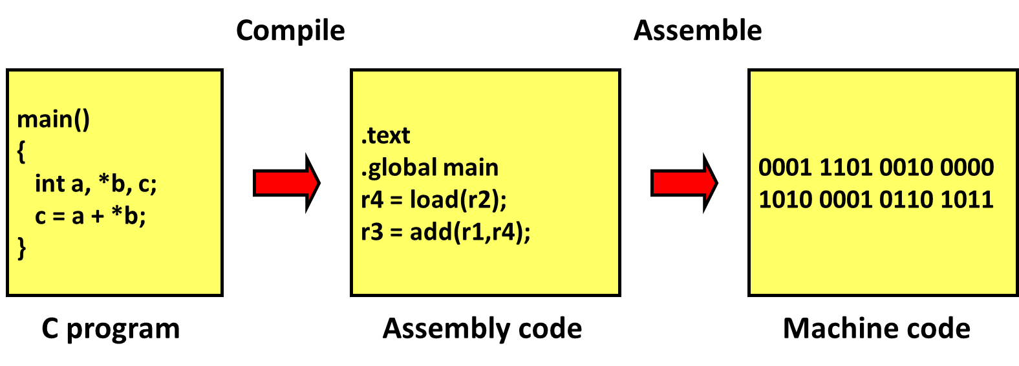
Software program to machine code
Example ISA
(simplified)

Slide 39
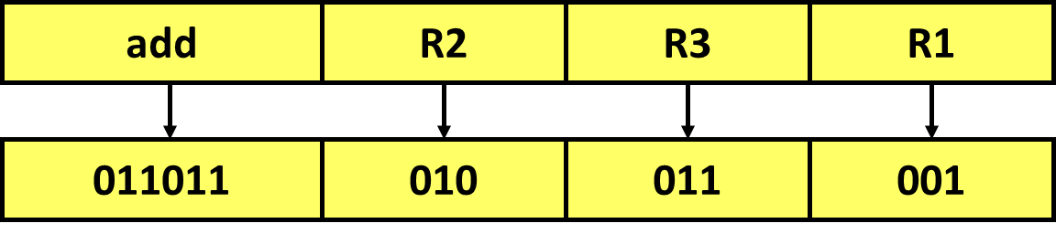
Assembly Instruction Encoding
Since the EDSAC (1949) almost all computers stored program instructions the same way they store data.
Each instruction is encoded as a number
This is the number stored in memory (in binary)!
Example ISA
(simplified)
011011010011001 = 2⁰ + 2³ + 2⁴ + 2⁷ + 2⁹ + 2¹⁰ + 2¹² + 2¹³
= 13977
Poll: How many different "operation codes" could be supported by this ISA? How many registers?
Live Poll + Q&A: slido.com #eecs370

Slide 40
Next Time
Finish Up ISAs
LC2K details
Lingering questions / feedback? I'll include an anonymous form at the end of every lecture: https://bit.ly/3oXr4Ah
Live Poll + Q&A: slido.com #eecs370

